Slide 1
GRAPH THEORY - MAXIMUM FLOW
Advanced Data Structures and Algorithms
Radim Burget
Radim Burget

Slide 2
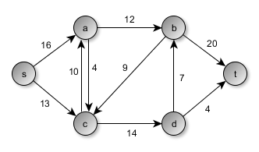
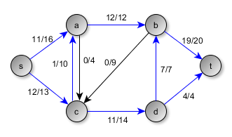
Objectives
    Get familiar with the network flow problem
    Understanding maximum flow
    Implementation the Edmonds Karp algorithm

Slide 3
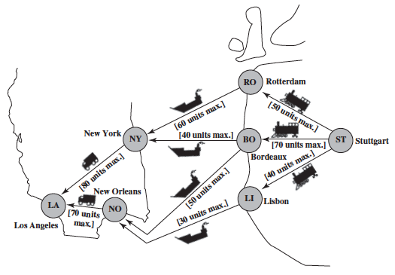
Motivation
How to distribute the load in the network effectively?
Applications:
  Telecommunication networks
  But also in other domains:
    Water pipes
    Transport
    VLSI design
    etc.
Thanks to the maximum flow we can find weaknesses of the network, so-called bottlenecks

Slide 4
Flow network - Setup
  Graph = (, )
    Oriented and weighted
  Each edge is directed and has assigned its weight
  The weight determines the capacity
  Source s and target t
Network capacity

Slide 5
Maximum Flow
Flow - assigning a value to each edge in the network
  The value must be positive
  The value must be less than the edge capacity
  The input flow must be equal to the output flow for each vertex (except s and t)
The problem of Max Flow:
  Found maximum flow between vertex s and t under the above conditions.

Slide 6
Maximum Flow
Example of network and its maximum flow (23):
Capacity
Flow
11+12=23
19+4=23

Slide 7
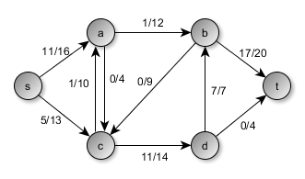
Bottleneck
This is the smallest free edge capacity in the path
  Note that in the case of the path s - c - d - b - t as a bottleneck is edge d - b with free capacity of 0. However, this ‘path’ should not be found...
Bottleneck = 3

Slide 8
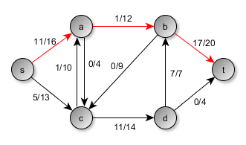
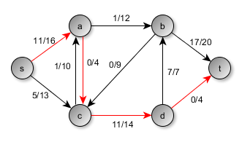
Residual graph
Reverse path
  Let’s have a path s – a – b – t, the residual path is t – b – a – s
  If the edges of the residual path do not exist, they must be created otherwise existing are used
11/12
5/16
3/20
5/16
1/14
4/4
3/14
The existing edge is used between c – a

Slide 9
Edmonds Karp algorithm
Based on Ford-Fulkerson algorithm, selects paths with BFS
  i.e. easier to implelment but worse complexity, O(|V|∙|E| ) vs O(|V|∙|E|²)
Pseudocode:
  while there is an augmenting path
  find an augmenting path
  compute bottleneck
  for each edge u -> v in the path (not randomly , using BFS. i.e. num of edges, not weights)
  decrease capacity u -> v by bottleneck
  (i.e. increase flow by bottleneck)
  increase capacity v -> u by bottleneck (residual)
  (i.e. decrease flow by bottleneck (residual))
  increase maxflow value by bottleneck
Recommended approach

Slide 10
Ford-Fulkerson Max Flow
4
2
5
3
1
1
1
2
2
s
4
t
3
2
1
3
This is the original network.

Slide 11
Ford-Fulkerson Max Flow
4
2
5
3
1
1
1
2
2
s
4
t
3
2
1
3
Choose a shortest path from s to t.

Slide 12
Ford-Fulkerson Max Flow
4
2
5
3
1
1
1
2
2
s
4
t
3
2
1
3
This is residual graph after the 1st augmentation.

Slide 13
Ford-Fulkerson Max Flow
4
2
5
3
1
1
1
2
2
s
4
t
3
2
1
3
Choose a shortest path from s to t.

Slide 14
Ford-Fulkerson Max Flow
4
2
5
3
1
1
1
2
2
s
4
t
1
1
2
2
3
The residual graph after the 2nd augmentation.

Slide 15
Ford-Fulkerson Max Flow
4
2
5
3
1
1
1
2
2
s
4
t
1
1
2
2
3
Choose a shortest path from s to t.

Slide 16
Ford-Fulkerson Max Flow
3
2
5
1
2
1
1
1
1
2
2
s
4
t
1
1
2
2
3
The residual graph after the 3rd augmentation.

Slide 17
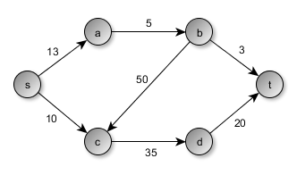
Task 1 – Define graph
P01_executable.java
Task 1.1:
Get familiar with the existing code
  Import the project
    The data model is already implemented
    The algorithm to find path is also implemented using BFS
Task 1.2: Model the graph in the memory
  Graph g = new Graph();
  g.addToGraph("s", "a", 13);
  …
  …
  System.out.println(g);
NOTICE: you can copy/paste the graph from P05_executable class.

Slide 18
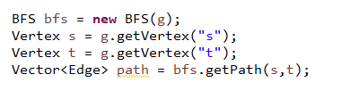

Task 2 – Get path
P01_executable.java
  Task 2.1: Find the path between „s“ – „t“ in the modeled graph. Notice the path and the edge capacity
  Task 2.2:
  1) Change the flow edges s -> a to 13​
  2) Find the path between „s“ - „t“ again and notice the output differs​
  3) There is also an edge without free capacity in this path​
(continued next slide)
Needs to be implemented
Graph [vertices= [a, b, s, c, d, t], edges=[[s->a, 13/13], [s->c, 0/10], [a->b, 0/5], [b->c, 0/50], [c->d, 0/35], [b->t, 0/3], [d->t, 0/20]]]

Slide 19
Task 2 – Change getter neighbours
P01_executable.java
Not possible to use this edge!!!
  An edge with no free capacity also exists in the path
  s->a 13/13 - this edge should not be considered in search
  Task 2.3: Resolve this issue
  You simply need to adjust the method:
    getPossibleNeighbors() in the class Graph
    After correcting, start searching for the path between „s“ – „t“
  Now, another path should be found (all the edges in the path must have free capacity now)
0/
13/
0/
0/
0/
0/
0/
13/
0/
Hint: Calculate the difference between capacity and flow for each edge, use edge.getCapacity() and edge.getFlow()
0/
0/
0/

Slide 20

Task 3 - Bottleneck
P01_executable.java
For the maximum flow algorithm, it is necessary to find the so-called bottleneck in the path​
  I.e. the smallest free edge capacity in the path
Task 3.1: Modify the method getBottleneck() in the class MaxFlow​
Hint: iterate through each edge and compute difference between capacity and flow. Use methods getCapacity() and getFlow(). The least difference is bottleneck.
Task 3.2: Set flow for edge s->a value 11
(implement in P01_executable.java).
Task 3.3: Get bottleneck in path (implement in P01_executable.java)
Bottleneck is 2 (13-11)
0/
11/
0/
0/
0/
0/

Slide 21
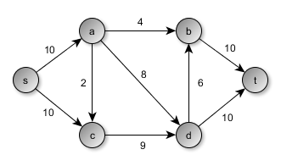
Implement Edmonds Karp algorithm
Implement the Edmonds Karp algorithm to find the maximum flow
Check the functionality on the following graphs
  There are more possible implementations, of course, one of the possible solutions is on the following slides.
Max flow = 15
Max flow = 19
Notice: your result is just 17 at the moment (no residual paths)

Slide 22
Task 4_1
P02_Edmonds_Karp.java
Start with finding one solution
  Task: Increase the flow by bottleneck for each edge in the path. Use getFlow() and setFlow() from edge class
  To control it, you can a display graph where you can see changes in the flow values in each edge

Slide 23
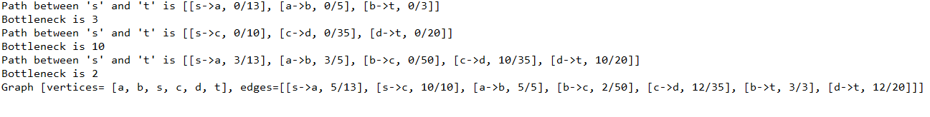
Task 4_2
P02_Edmonds_Karp.java
Task: Create an algorithm which searches for all paths between two vertices:
  Do not solve residual paths yet
  Be sure to increase the flow for each edge in the path, otherwise the program will probably loop
  Note if the path does not exist, BFS returns null
Pseudocode:
While (path exists) {
Compute bottleneck
For edge in path {
Increase edge flow by bottleneck (see Task 4_1)
}
Compute path
}

Slide 24
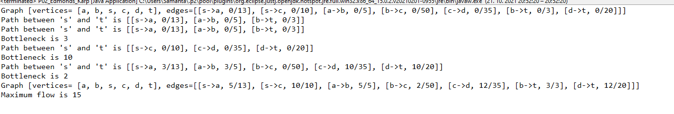
Task 4_3
P02_Edmonds_Karp.java​
Task: Get the value of the final maximum flow (sum of bottlenecks)
At this point, the program should "correctly" calculate the maximum flow for the first graph.

Slide 25

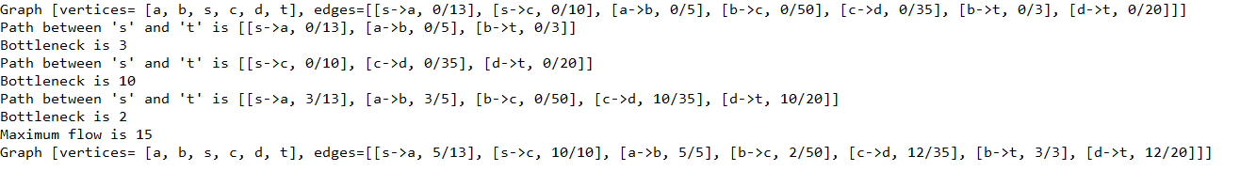
Task 4_4
P03_executable.java​
Task: Integrate (don't just copy it) the generated maximum flow code into the computeMaxFlow() method in the MaxFlow class
The call of the method will be look like this:
Task: Run P03_executable.java
You will see in the list of the paths which edges are extracted

Slide 26
Task 4_5
P04_residual_path.java
Task: Implement a method residualPath() that iterates the edges in the residual path. Follow according conditions:
  If there is an edge, the existing one is used
  If the edge does not exist, it must be created
    Attention: it is created only once and is further used in the graph for max flow purposes
    The residual edge has the same capacity as the original edge
    The residual edge has a flow value equal to the bottleneck value
  HINTS: Edge.getStart(), Edge.getEnd(), Edge.getCapacity(), Graph.getEdge(), Graph.addToGraph()

Slide 27
Task 4_6
P04_residual_path.java
Task: Add the int bottleneck input parameter to the method residualPath().
Task: For each residual edge, decrease the flow value by the bottleneck value
Task: Before calling a method, get the value of the bottleneck path and send it as a parameter.

Slide 28
Task 4_7
P05_executable.java
Task: Copy the created method residualPath() to the MaxFlow class
  You will need to remove the static modifier from the method
Task: Integrate it into the computeMaxFlow() method (after setup of flow in edges)
Task: Make a second graph and call the method to calculate max flow (run P05_executable.java)

Slide 29
Task 4_7 continuation
P05_executable.java
Task: After the algorithm is finished, the residual paths must be deleted from the graph.
  Save residual paths to vector resEdges in residualPath() method
  Remove all residual paths in computeMaxFlow() method (use g.getEdges().removeAll(resEdges);)
If everything works correctly, the program calculates the correct maximum flow value for both graphs.
Print down the resulting graph to see if the residual paths are really in the graph.

Slide 30
Thank you for your attention…

